Slide 1


IE2091
Information Systems Project
Lecture 01
Introduction to Information Systems Project
Mrs. Narmada Gamage
Faculty of Computing

Slide 2
Session Outline
Module overview & expectations
What is an Information Systems Project?
Industry-based IS project examples
Project scope definition
Project objectives, goals & constraints
Agile mindset vs traditional approach

Slide 3


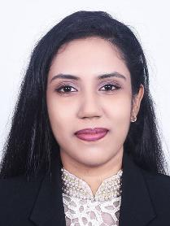
Lecture Panel
Ms. Narmada Gamage
Lecturer
Department of Computer Systems Engineering
narmada.g@sliit.lk
Ms. Naduni Ranatunga
Instructor
Department of Computer Systems Engineering
naduni.r@sliit.lk
Ms. Hiruni Peiris
Instructor
Department of Computer Systems Engineering
hiruni.p@sliit.lk

Slide 4
Module Identification
Module Name: Information Systems Project (ISP)
Module Code: IE2091
Credit Points: 4
Module Status: Compulsory
Duration: One Semester

Slide 5
Module Delivery
Formal
Informal
2 hrs Lecture per week
1 hr Tutorial per week
2 hrs Lab session per week
Group discussions among the group members
Members participating in project related work
Meeting lecturer & supervisor (by appointment) Team Leader should communicate
Meeting your client (by appointment)

Slide 6
Mode of Delivery
Resources and Materials
Delivered using the courseweb.
Notices
Published on the courseweb module page
Check the module page regularly

Slide 7
Learning Outcomes
LO1: Utilize project management agile methods, tools, and techniques to address an industry-related problem.
LO2: Analyze needs, identify stakeholders, and create project plans aligned with goals and customer expectations.
LO3: Produce documents with background information, goals, methodologies, and success metrics for implementation.
LO4: Develop skills in communication, collaboration, and teamwork in an agile project environment.
LO5: Demonstrate continuous improvement and adaptability in response to changing project requirements and stakeholder needs.

Slide 8


Slide 9

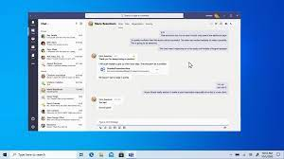
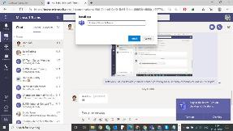
Project categories
You can develop a,
Desktop Application or
Mobile Application or
Web Application
E.g. Microsoft Teams
Mobile Application
Desktop Application
Web Application

Slide 10
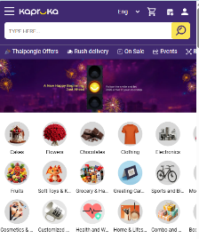
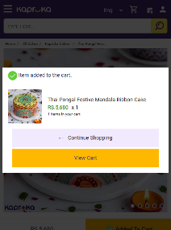
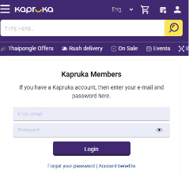
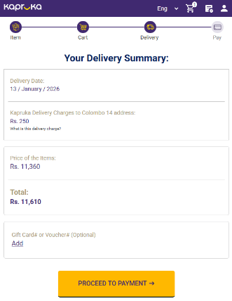
E.g., Online Shopping Application
Payment Management
Items Management
Customer Management
Selection Management

Slide 11



E.g., Items Management Component
Create
Retrieve
Update
Delete
User Actions
Items Management
Response
DB
Response
Mobile/Desktop/Web Application
Items Database
Kapruka.com | Sri Lanka Online Shopping Site | Send Gifts to Sri Lanka

Slide 12
Project Scope
Select a project with correct scope
Scope must not be too large or too small for 14 weeks duration
Project must have five business functions

Slide 13
Contribution of the Team Members
Requirement Analysis
Design
Development
Testing
Integration
You must handle your function end-to-end

Slide 14
Assessments
1. Sprint 0 | 20 | %
2. Sprint Plans | 10 | %
3. Sprint 1 | 10 | %
4. Sprint 2 | 20 | %
5. Sprint 3 Marketing Video Product Demo Viva Report | 40 | %
TOTAL | 100 | %

Slide 15
Assessments
During an evaluation, all members must be present
Some evaluations may held during the lecture and the tutorial sessions
Most evaluations are group activities
A “common mark” is not given for the entire project
In every assessment the contribution of each member is assessed
Thus, to pass the unit every member’s involvement in all project stages and activities are necessary

Slide 16


Project Milestones
Week 1
Week 2
Week 3
Week 4
Week 7
Team Registration
Finalize Product vision
Supervisor Assignment
Sprint 0 : Submission &
Presentation
Sprint 1 : Presentation
Week 14
Week 12
Week 11
Week 9
Sprint 3:
Demo & VIVA
Sprint 3 plan submission
Sprint 2 : Presentation
Sprint 2 plan submission

Slide 17
Reasons for Failures
Beginning programming before understanding the problem
A team that begins programming too soon will end up writing good software that solves the wrong problem
Not understanding the workload involved
Not having a good sense of the overall state of the project

Slide 18




Succeeding the Project
Refresh and improve the technical knowledge required
E.g., Coding using JAVA or .NET, Database Management, UI Development, Integration
Good teamwork
Have a good communication within the team
Share all the documents and resources with the team
Make decisions as a team
Develop quality software from the beginning
Good presentations during important milestones

Slide 19










What is the best SDLC model?
Traditional Waterfall Model
Analysis
Design
Develop
Test
Deploy

Slide 20


Waterfall Requires Perfect Vision
Waterfall calls for a fully formed idea up front.
And, doing it on time requires very accurate estimation.
3 4 5
1
2

Slide 21






Agile Expects Vision Shift
…builds a rough version, validates it, then slowly builds up quality
A more iterative method allows you to move from vague idea to realization making course corrections as you go….stop when diminishing returns are encountered!
3 4 5
1
2

Slide 22
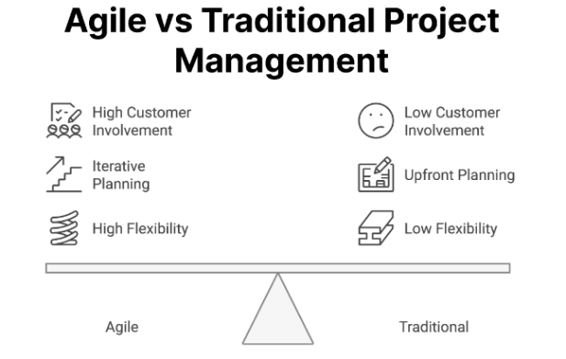
Why Agile for Information Systems Projects?
Information Systems projects face changing requirements
Clients often refine needs after seeing working software
Technology, tools, and user expectations evolve rapidly
Agile helps teams:
Deliver value early
Adapt to change
Reduce project failure risk
Notes:
Waterfall Vs Agile
Fixed requirements → Evolving requirements
Late testing → Continuous testing
Big final delivery → Incremental delivery
High risk → Reduced risk

Slide 23
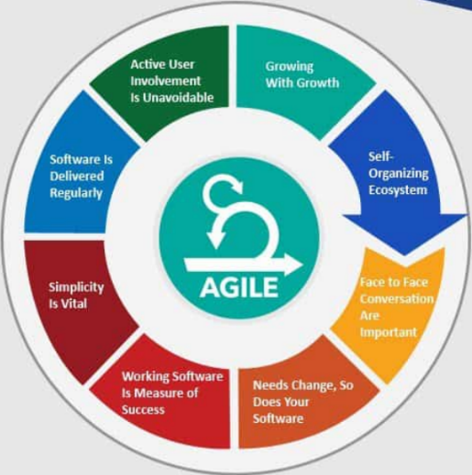
Key Principles of Agile Methodology
Individuals and Interactions over processes and tools
Working Software over comprehensive documentation
Customer collaboration over contract negotiation
Responding to change over following a plan
While we value the items on the right, we value the items on the left more

Slide 24
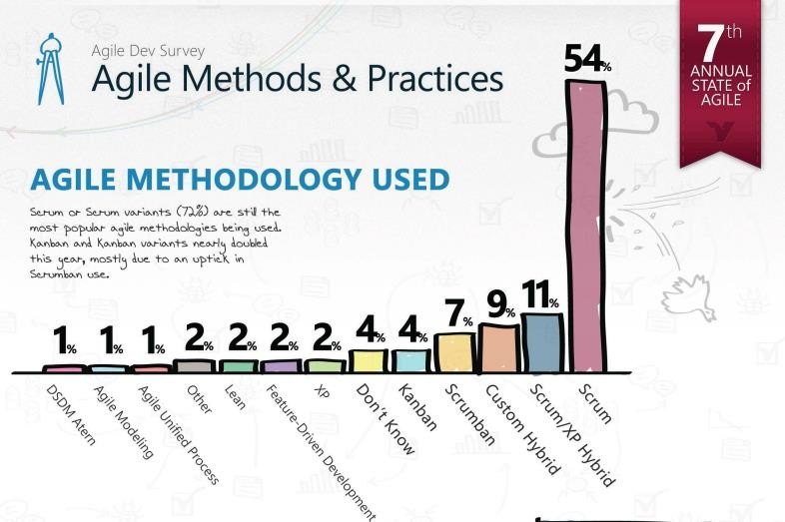

Slide 25
SCRUM
“An agile framework that allows us to focus on delivering the highest business value in the shortest time” -Mike Cohn
The fastest growing approach to software development
Scrum is not a process or methodology . It is a framework that implements Agile
Used by many fortune 100 companies
Google, Microsoft, Sun, IBM, Nokia, HP, Infosys

Slide 26
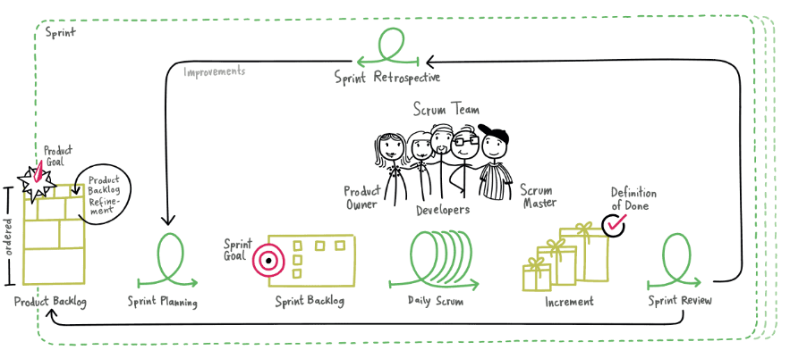
SCRUM Framework

Slide 27
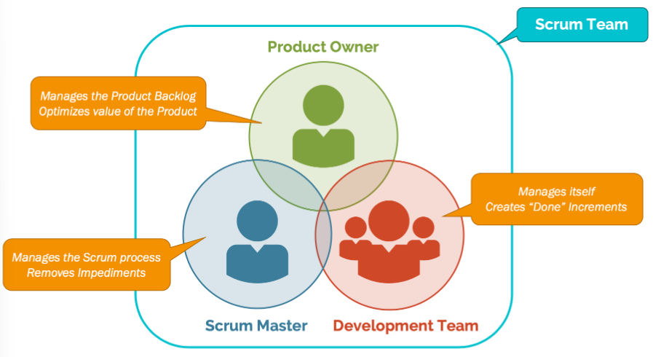
Roles
Product owner
Scrum master
Team
Ex :
Client / Supervisor → Product Owner
Team Leader → Scrum Master
Group Members → Dev Team
Notes:
Product Owner
Represents client
Owns product backlog
Scrum Master
Facilitates Scrum
Removes blockers
Development Team
Design, code, test, integrate

Slide 28
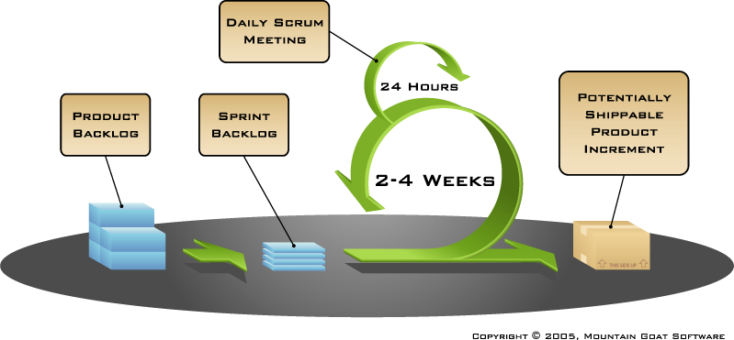
Artifacts
Product backlog
Sprint backlog
Burndown charts

Slide 29


Sprint Planning
How do we do it?
Daily Scrum
How are we doing?
Sprint Review
How did we do it?
Sprint Retrospective
How do we do better?
Ceremonies
Sprint planning
Daily scrum
Sprint review
Sprint retrospective

Slide 30
Next Week
Agile project plan preparation : Sprint 0 in IE2091
Project vision
Stakeholder identification
High-level backlog
Architecture & tools
Risk identification

